Slide 1

Introduction to
Web Development
Mentor
Gagan Sharma
Education Outreach 2
Organised by: Girlscript

Slide 2
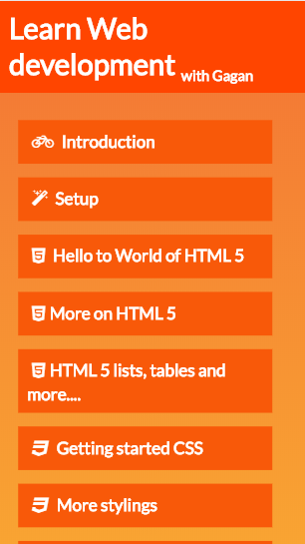
The Course outline
The complete course outline is available at:
webdevwithgagan.orgfree.com/

Slide 3

World of Web!
Web is present,
Web is future.

Slide 4




Don’t stop at websites,
because web doesn’t either.

Slide 5











We use web

Slide 6

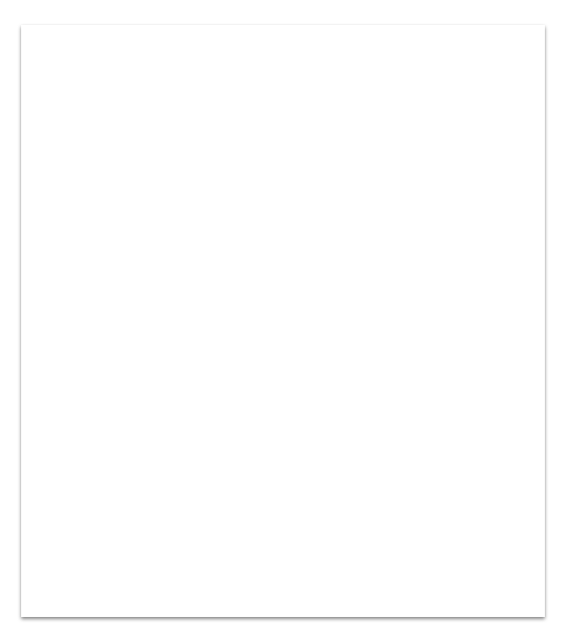
This Course
A basic website uses mainly 3 technologies.
HTML Create basic structure of your website
CSS Add stylings.
Javascript Add interactivity to your website.

Slide 7




Contact me:
t.me/GaganSharma3103
gagan3103sharma2000@gmail.com
linkedin.com/in/gagan-sharma3103

Slide 8


Setup

Slide 9
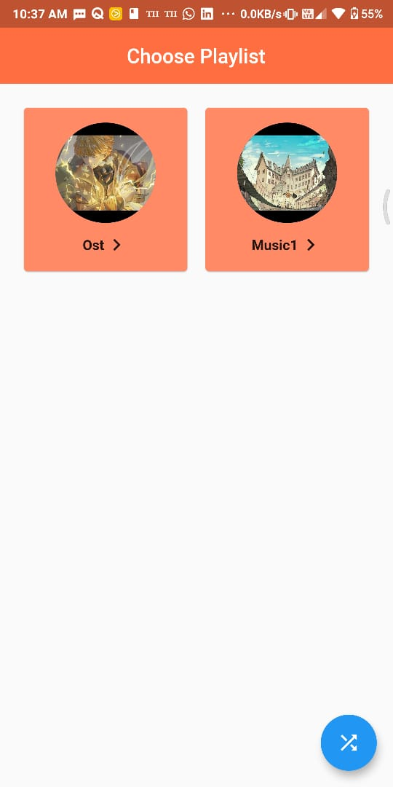
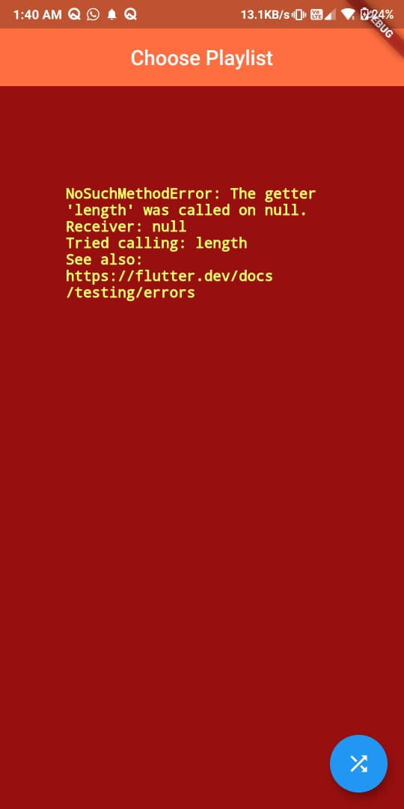

The story
of Amuzic

Slide 10
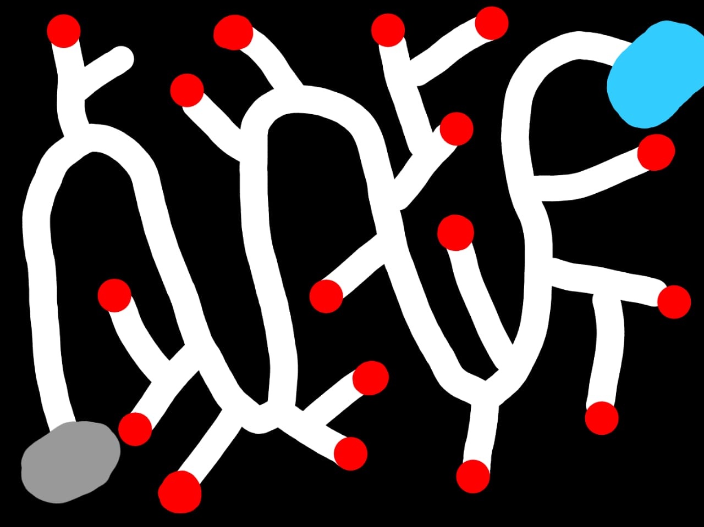
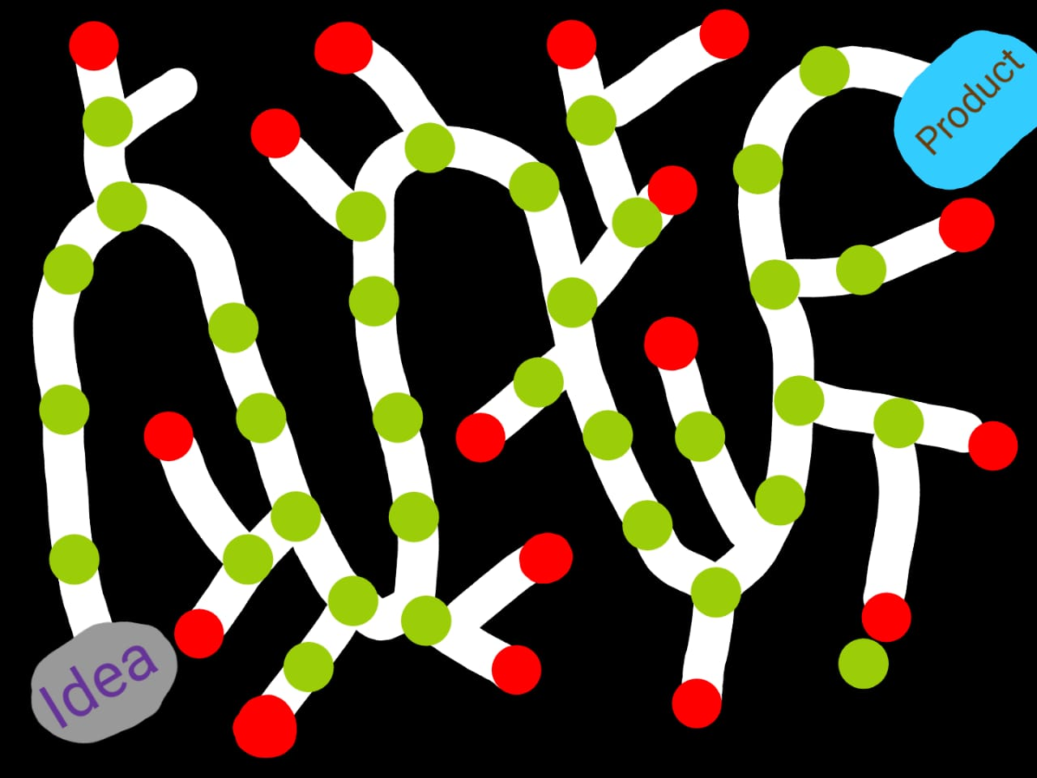
Git saves developers

Slide 11

HTML
What actually is HTML?
Hyper Text Markup Language
Let’s head to html.com for more info

Slide 12
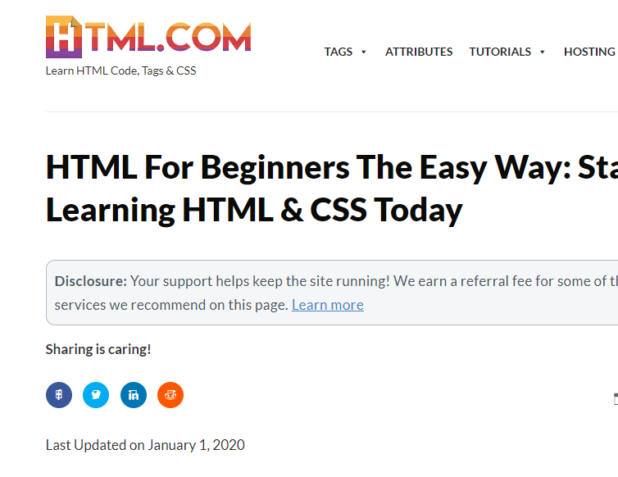
HTML.com
Link
Image
The language which tells browser which part of webpage has what role is HTML
Heading
Box
Buttons

Slide 13

Tags
HTML does it’s job using tags. Just like tags on products in market, an HTML tag has no meaning of it’s own, it only exists to give information about something else.
To differentiate tags with HyperText we use <>.
Ex. <head>,<p>

Slide 14
</> Types of Tags
Closing tags:
They have an opening and closing, they define properties of data present between opening and closing.
Ex <p>birds are cool</p>
Non-closing tags:
They are standalone tags that are not need to be closed.
Ex <br>

Slide 15
Hello to World of HTML 5
HTML
Head
Tags:
It’s all about tags.
<HTML></HTML>
<IMG/>
<TABLE>
Body

Slide 16
Let’s jump into VSCode
and
start developing.

Slide 17
Basic HTML tags
<!DOCTYPE>
<HTML></HTML>
<HEAD></HEAD>
<TITLE></TITLE>
<BODY></BODY>
<H1>………<H6>
<P></P>
<BR>
<HR>

Slide 18
Let’s jump into VSCode
and
start developing.

Slide 19
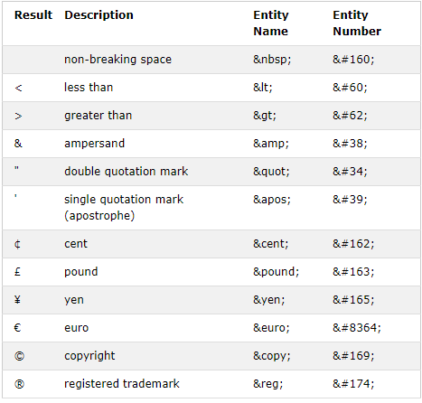
Comments
White Spaces
HTML ignores enters and multiple spaces.
Because developers work together :)
Nesting Elements
Elements inside elements

Slide 20
Let’s jump into VSCode
and
start developing.

Slide 21
Text formatting tags
Bold
Italic
Deleted
Marked
Subscript
Superscript
Code
Underline

Slide 22
Let’s jump into VSCode
and
start developing.

Slide 23
Some other tags
Spans
Div
Buttons
Cite
Blockquote

Slide 24
Let’s jump into VSCode
and
start developing.

Slide 25
Attributes
Attributes are properties of an element each tag has it’s own special set of attributes, you can also define custom attributes for your tags
<html lang=“en-US”></html>
<p title=“this has a title”></p>

Slide 26
Let’s jump into VSCode
and
start developing.

Slide 27
IDs and Classes
The id attribute specifies a unique id for an HTML element
<p id=‘”turtle”></p>
The class attribute specifies a group an HTML element belongs to.
<p class=“reptile”></p>

Slide 28
Let’s jump into VSCode
and
start developing.

Slide 29
Links
Anchor tag:
<a>
Attributes:
Href= url, id, mailto:, tel:
target =_blank,_parent,_self,_top, framename
download

Slide 30
Let’s jump into VSCode
and
start developing.

Slide 31
Images
Image tag:
<img>
Attributes:
Src
Height, width
Alt

Slide 32
Let’s jump into VSCode
and
start developing.

Slide 33
Block tags
These tags are basically div tags specialized for one purpose.
Section
Header
Footer
Main
Article
Summary

Slide 34
Let’s jump into VSCode
and
start developing.

Slide 35
Lists
Creates a list of hypertext, there are 3 types of lists
Ordered list
Unordered list
Description list

Slide 36
Ordered list
This tag created a numbered/ordered list.
<ol>
<li>first</li>
<li>second</li>
<li>third</li>
<li>fourth</li>
</ol>
Attributes:
Start=number
reversed
Type= 1, a, A, I, i

Slide 37
Let’s jump into VSCode
and
start developing.

Slide 38
Unordered list
This tag created a numbered/ordered list.
<ul>
<li>first</li>
<li>second</li>
<li>third</li>
<li>fourth</li>
</ul>

Slide 39
Let’s jump into VSCode
and
start developing.

Slide 40
Tables
Tags:
caption
tbody
tr
td
thead
th
tfoot
This tag creates an HTML table.
<table> <thead> <th>Pet</th> <th>Score</th> </thead> <tr> <td>Bird</td> <td>100</td> </tr> </table>

Slide 41
Let’s jump into VSCode
and
start developing.

Slide 42
Form
This tag creates an HTML table.
<form> <label for=“pet">Pet:</label> <input type="text" id=“pet" name=“pet"><br><br> <label for=“name">Name:</label> <input type="text" id="name" name="name"><br><br> <input type="submit" value="Submit"> </form>
Attributes:
Name= text
Accept-charset= character_set
Name = ‘Text’

Slide 43
Form tags
Input:
TextArea:
Multi line text input
Select:
selection in options
options:
select options
Label:
label for elements
Buttons
Attributes:
Type=
Button
checkbox
Date
Email
file
Number
Password
Radio
Range
Reset
Search
Submit
Tel
text
Value= default
Name = ‘text’
Required

Slide 44
Let’s jump into VSCode
and
start developing.

Slide 45
Videos and audios
Adds video/audio to page.
<video > <source src=“duckTales.mp4"
type="video/mp4"> <source src=“duckTales.ogg“
type="video/ogg"> Your browser does not support the video tag. </video>
Attributes:
Controls
Muted
Poster=‘imageURL’
Loop
Autoplay

Slide 46
Let’s jump into VSCode
and
start developing.

Slide 47
iFrames
iFrame lets you insert a page within a page.
<iframe src=“http://webdevwithgagan.orgfree.com/”>
</iframe>
Attributes:
Allowfullscreen=true/false
Allowpaymentrequest
SRC

Slide 48
Let’s jump into VSCode
and
start developing.

Slide 49
Introduction to Web Development
Doubt break
Please go through everything taught today and let me if any part is unclear we will continue tomorrow by then practice whatever you have learnt, contact me if any problem arises.
Organised by: Girlscript
Mentor: Gagan Sharma

Slide 50

Class end
Practice everything you learned today, share your doubts and projects on the slack channel.

